Slide 1
VERONICA & COLIN
MAY 2ND, 2026
59 GUESTS
CHÂTEAU D’AVENY

Slide 2
PAPETERIE

Slide 3
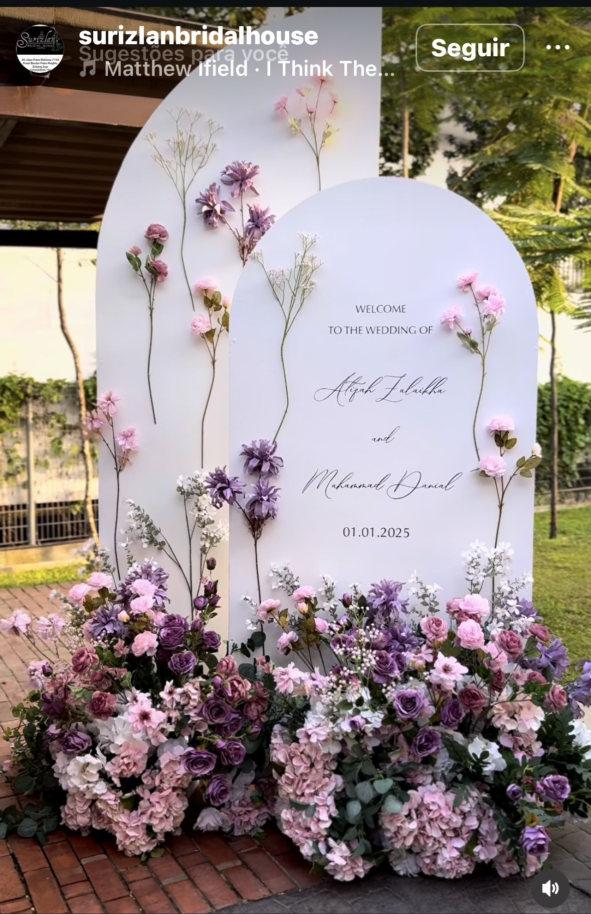
Welcome Sign & Décor
The white welcome sign, featuring typography and detailing inspired by the reference image, without flowers.

Slide 4
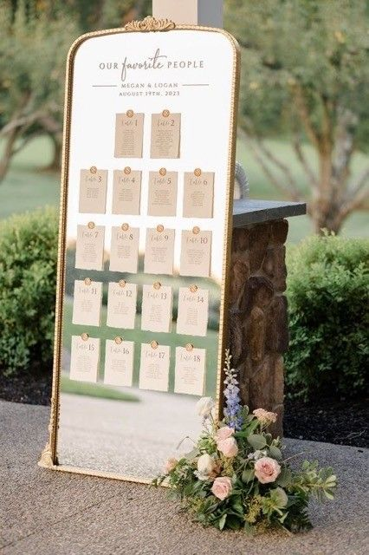
Seating Chart
A large rectangular gold-framed mirror will display the seating chart, featuring wax-sealed, gold-stamped cards elegantly presenting each guests’ by alphabetic order.
A medium-sized floral arrangement will be displayed at the base of the seating chart, with décor echoing the reference imagery and styled in harmony with the color palette detailed on slide #2

Slide 5
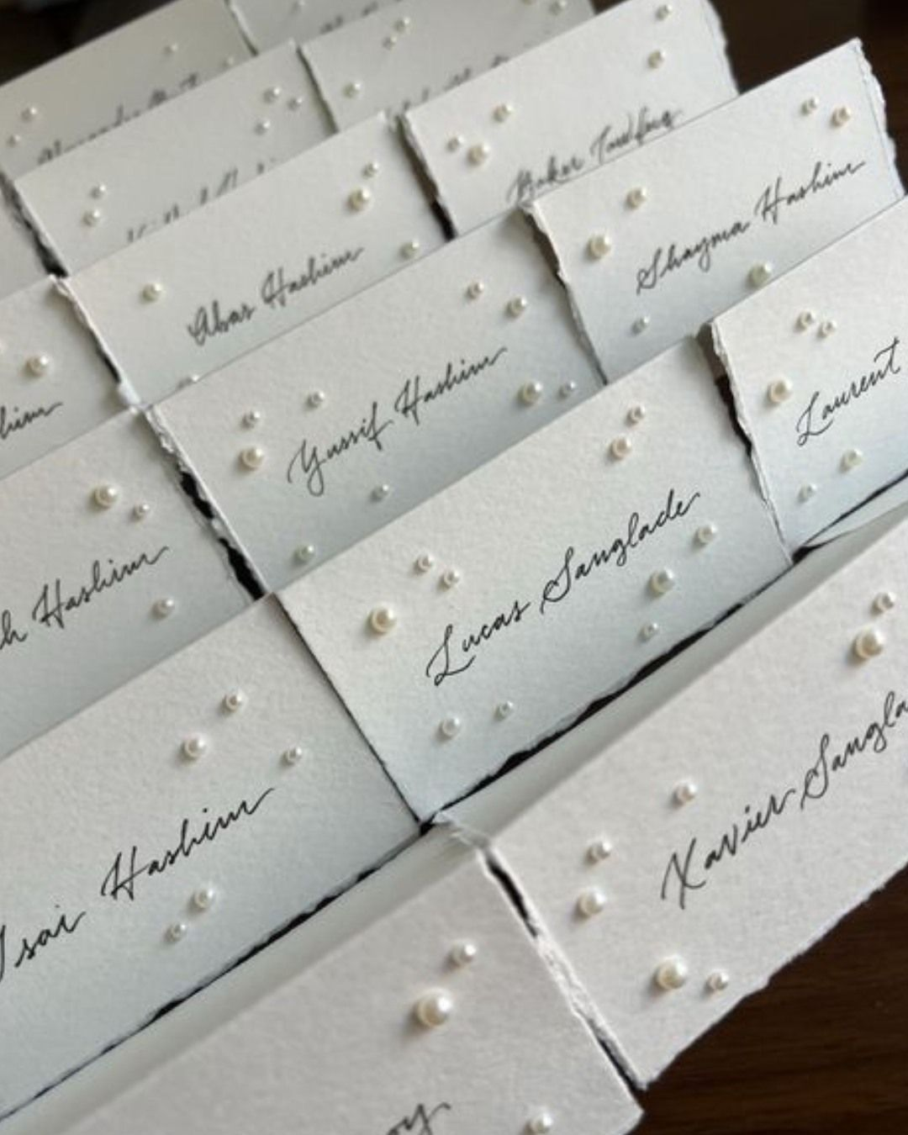
Place Cards
Audrey’s Note:
Please note that place cards are required by the catering staff regardless of round or rectangular tables. For weddings with more than 100 guests, place cards must be placed on each table with assigned seating, showing each guest’s full name, table number, and a meal icon/allergy note to guide the staff.

Slide 6
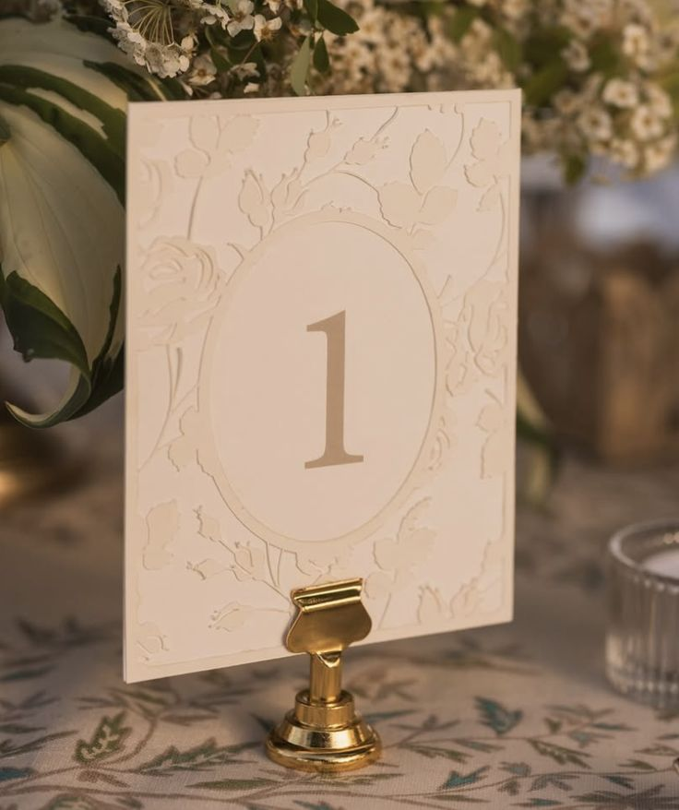
Table numbers
A refined rectangular design, printed on white paper and enhanced with warm-white floral motifs and gold script typography, will be elegantly displayed on a gold holder

Slide 7
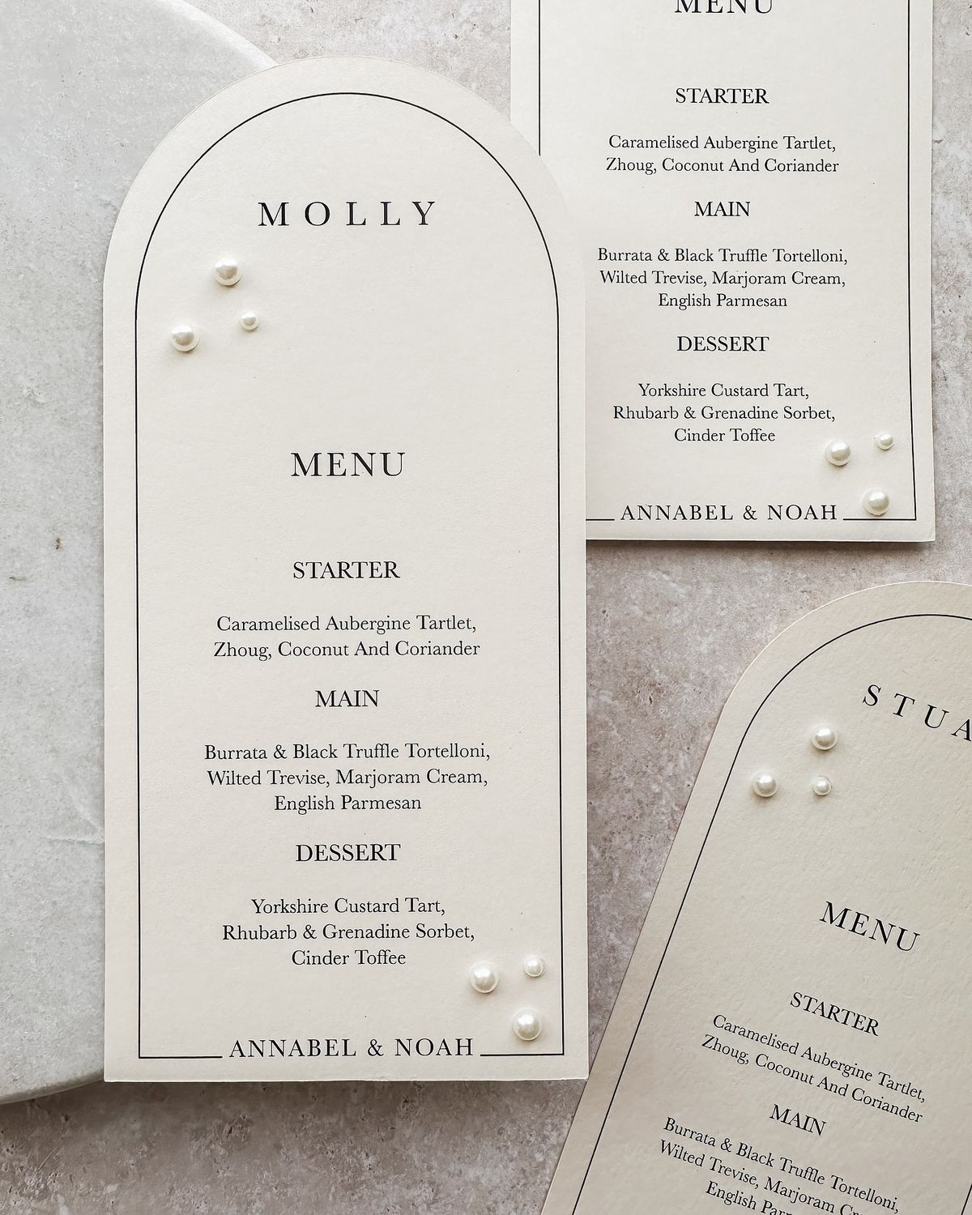
Menus
A large rectangular format with a rounded top, crafted from white, smooth, thick matte paper, featuring elegant dark script typography and enhanced with white pearls for a sophisticated, harmonious touch

Slide 8
NOTES POUR LA DESIGNER PAPETERIE:
59 PLACE CARDS (SANS LES PERLES)
59 MENUS (AVEC PERLES)
2 NUMEROS DE TABLES (1 & 2) AVEC LE SUPPORT DORÉ SIMILAIRE A LA PHOTO
WELCOME SIGN - LES FLEURS PEUVENT ETRE FOURNIES PAR NOTRE FLEURISTE SUR PLACE CEPENDANT IL LUI FAUDRA UN SYSTEM “D’ACCROCHE” MIS EN PLACE POUR QUE CA TIENNE.
1 SEATING CHART – PAR ORDRE ALPHABETIQUE
REHEARSAL DINNER (PARIS SEINE) – DESIGN SIMPLE, NOUS AVONS CARTE BLANCHE MAIS LE PLUS MINIMALISTE POSSIBLE.
59 PLACE CARDS
6 NUMEROS DE TABLES

